Slide 1

Adversarial Search
Read AIMA Chapter 5.2-5.5

Slide 2
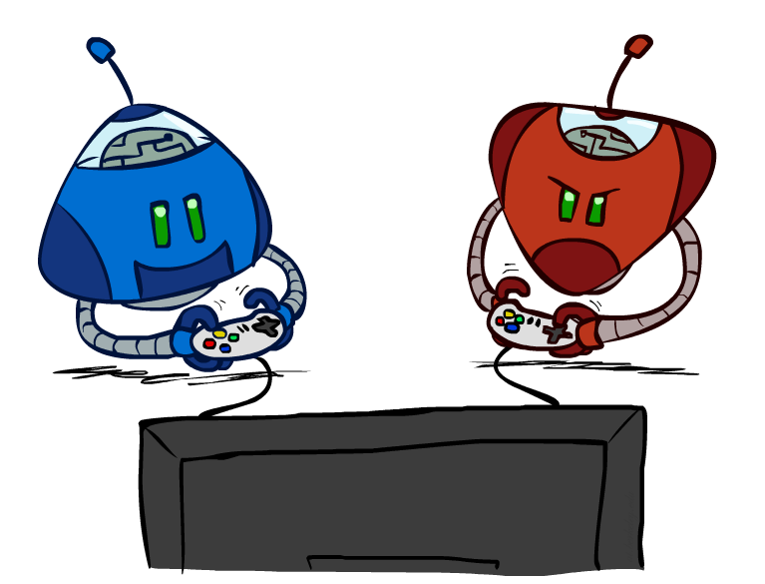
Adversarial Search
Instructors: Dan Klein and Pieter Abbeel
University of California, Berkeley
[These slides were created by Dan Klein and Pieter Abbeel for CS188 Intro to AI at UC Berkeley. All CS188 materials are available at http://ai.berkeley.edu.]
Notes:
Please retain proper attribution, including the reference to ai.berkeley.edu. Thanks!

Slide 3
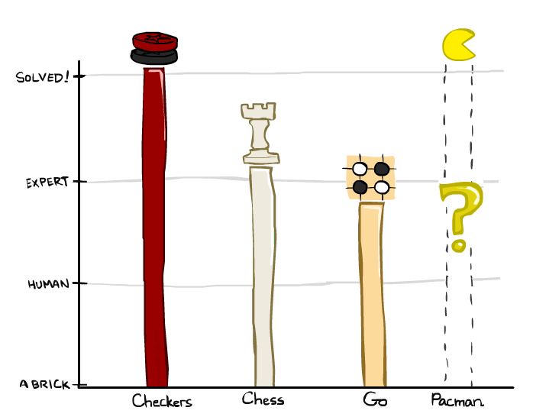
Game Playing State-of-the-Art
Checkers: 1950: First computer player. 1994: First computer champion: Chinook ended 40-year-reign of human champion Marion Tinsley using complete 8-piece endgame. 2007: Checkers solved!
Chess: 1997: Deep Blue defeats human champion Gary Kasparov in a six-game match. Deep Blue examined 200M positions per second, used very sophisticated evaluation and undisclosed methods for extending some lines of search up to 40 ply. Current programs are even better, if less historic.
Go: 2017: AlphaGo beat Ke Jie the number 1 ranked playerin the world. In go, b > 300! Classic programs use pattern knowledge bases, but big recent advances use Monte Carlo (randomized) expansion methods.
Pacman

Slide 4
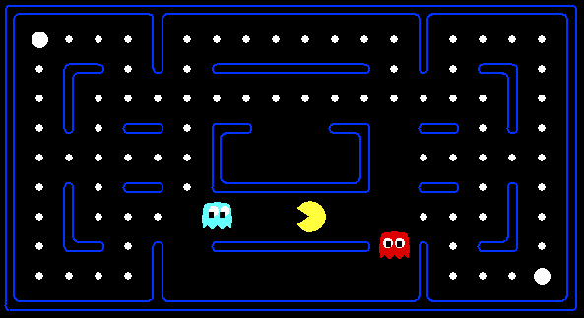
Behavior from Computation

Slide 5
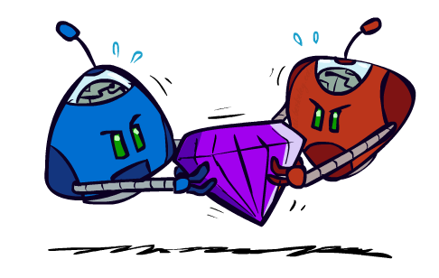
Adversarial Games

Slide 6
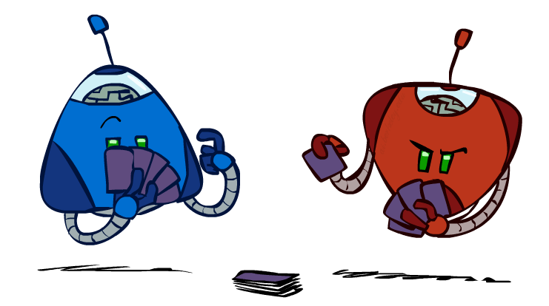
Types of Games
Many different kinds of games!
Axes:
Deterministic or stochastic?
One, two, or more players?
Zero sum?
Perfect information (can you see the state)?
Want algorithms for calculating a strategy (policy) which recommends a move from each state

Slide 7
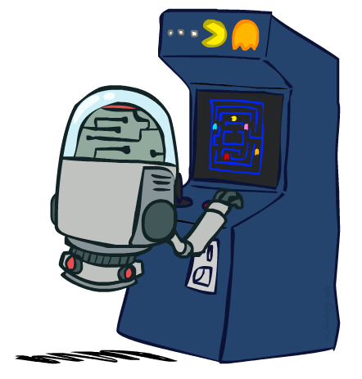
Deterministic Games
Many possible formalizations, one is:
States: S (start at s₀)
Players: P={1...N} (usually take turns)
Actions: A (may depend on player / state)
Transition Function: SxA → S
Terminal Test: S → {t,f}
Terminal Utilities: SxP → R
Solution for a player is a policy: S → A

Slide 8
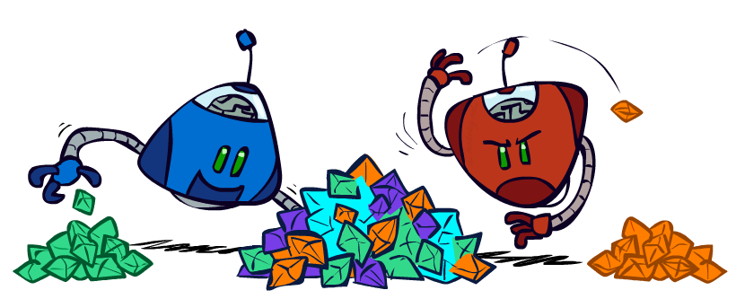
Zero-Sum Games
Zero-Sum Games
Agents have opposite utilities (values on outcomes)
Lets us think of a single value that one maximizes and the other minimizes
Adversarial, pure competition
General Games
Agents have independent utilities (values on outcomes)
Cooperation, indifference, competition, and more are all possible
More later on non-zero-sum games

Slide 9

Adversarial Search

Slide 10

Battle of Wits
https://www.youtube.com/watch?v=rMz7JBRbmNo

Slide 11
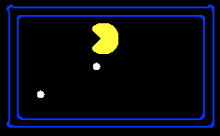
Single-Agent Trees
8
2
0
…
2
6
…
4
6

Slide 12
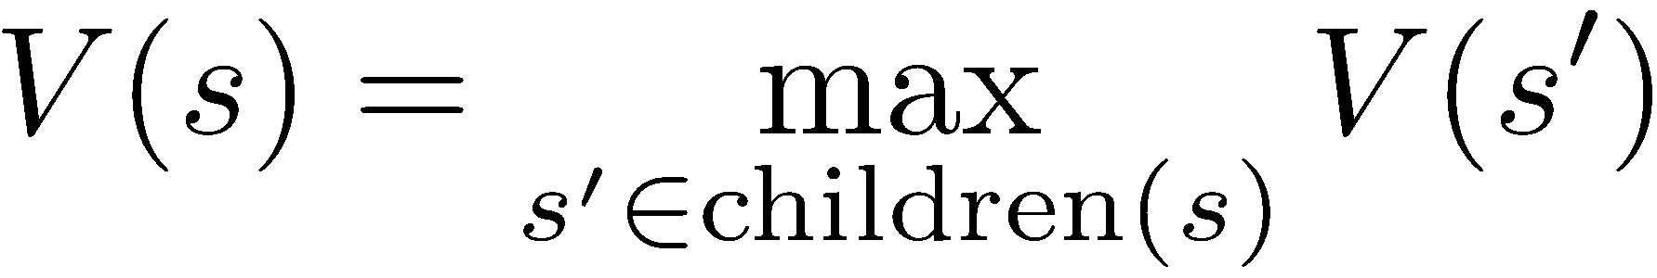
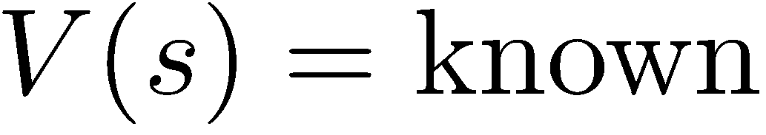
Value of a State
Value of a state: The best achievable outcome (utility) from that state
Non-Terminal States:
8
2
0
…
2
6
…
4
6
Terminal States:

Slide 13

Adversarial Game Trees
-20
-8
…
-18
-5
…
-10
+4
-20
+8

Slide 14
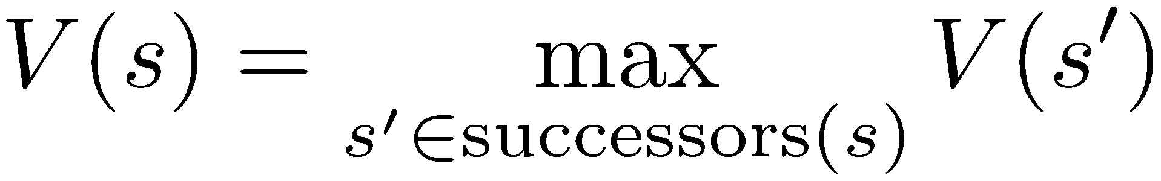
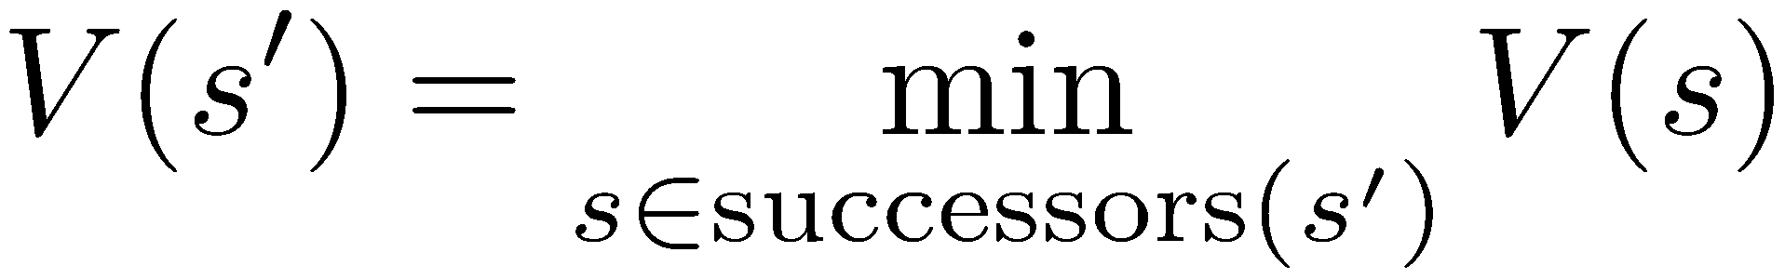
Minimax Values
States Under Agent’s Control:
States Under Opponent’s Control:
-8
-5
-10
+8
Terminal States:

Slide 15

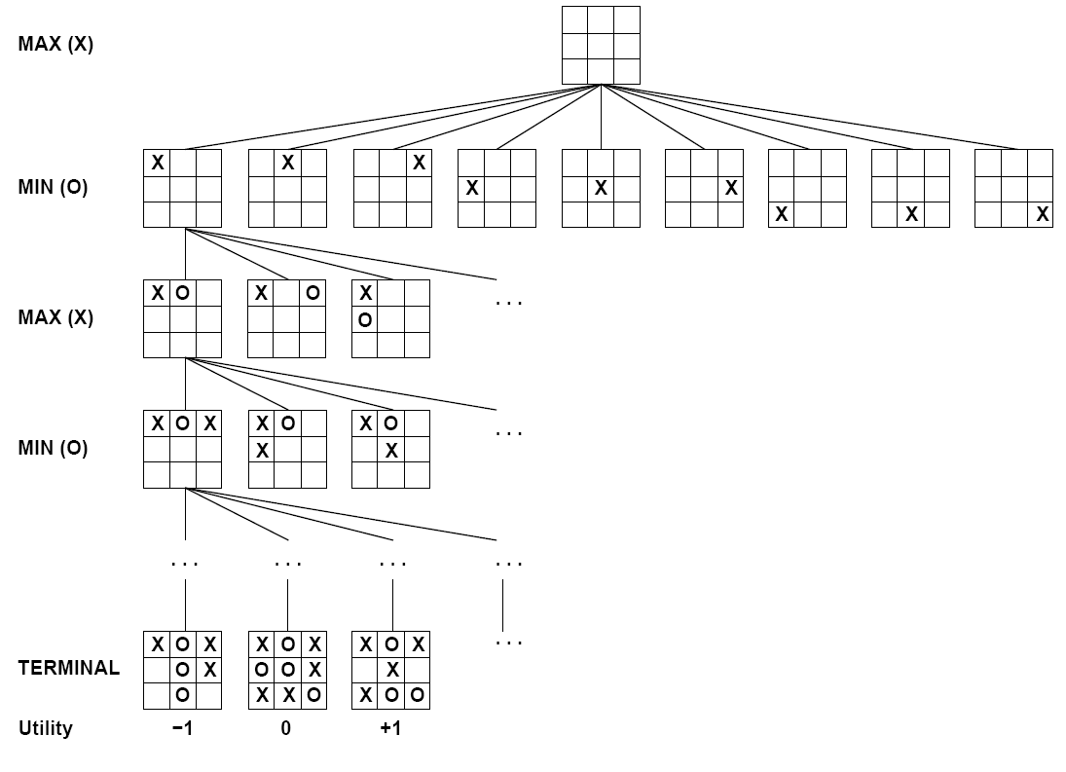

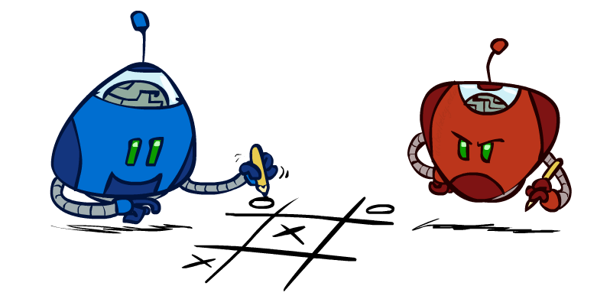
Tic-Tac-Toe Game Tree

Slide 16
Adversarial Search (Minimax)
Deterministic, zero-sum games:
Tic-tac-toe, chess, checkers
One player maximizes result
The other minimizes result
Minimax search:
A state-space search tree
Players alternate turns
Compute each node’s minimax value: the best achievable utility against a rational (optimal) adversary
Minimax values: computed recursively
5
max
2
5
min
8
2
5
6
Terminal values: part of the game

Slide 17
Minimax Implementation
def max-value(state):
initialize v = -∞
for each successor of state:
v = max(v, min-value(successor))
return v
def min-value(state):
initialize v = +∞
for each successor of state:
v = min(v, max-value(successor))
return v

Slide 18
Minimax Implementation (Dispatch)
def value(state):
if the state is a terminal state: return the state’s utility
if the next agent is MAX: return max-value(state)
if the next agent is MIN: return min-value(state)
def max-value(state):
initialize v = -∞
for each successor of state:
v = max(v, value(successor))
return v
def min-value(state):
initialize v = +∞
for each successor of state:
v = min(v, value(successor))
return v
Notes:
This allows you to also add in multiple MIN opponents. For instance, multiple ghosts in PacMan.

Slide 19
Minimax Example
3
12
8
2
4
6
14
5
2

Slide 20
Minimax Efficiency
How efficient is minimax?
Just like (exhaustive) DFS
Time: O(b^{m})
Space: O(bm)
Example: For chess, b ≈ 35, m ≈ 100
Exact solution is completely infeasible
But, do we need to explore the whole tree?

Slide 21
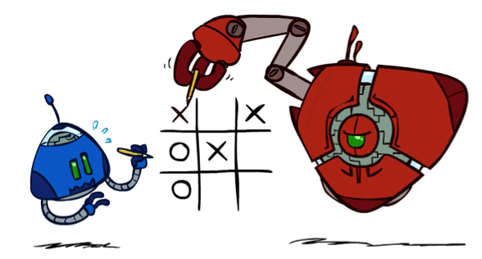
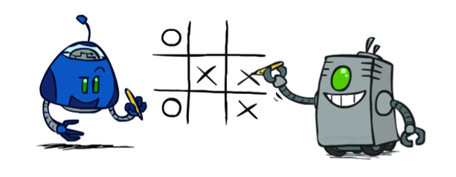
Minimax Properties
max
min
10
10
9
100
Optimal against a perfect player. Otherwise?

Slide 22
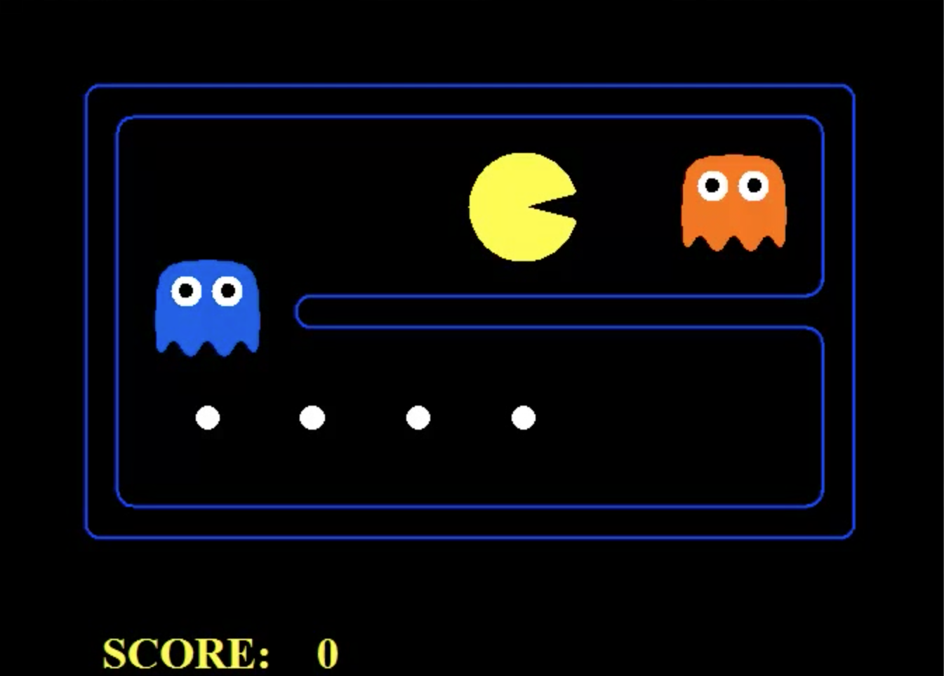
What should PacMan do?
Notes:
Assume ghosts are perfect adversaries. Lose 1 point for every move
Suicide! If living longer you might as well finish it now (in the context of Pacman only).

Slide 23
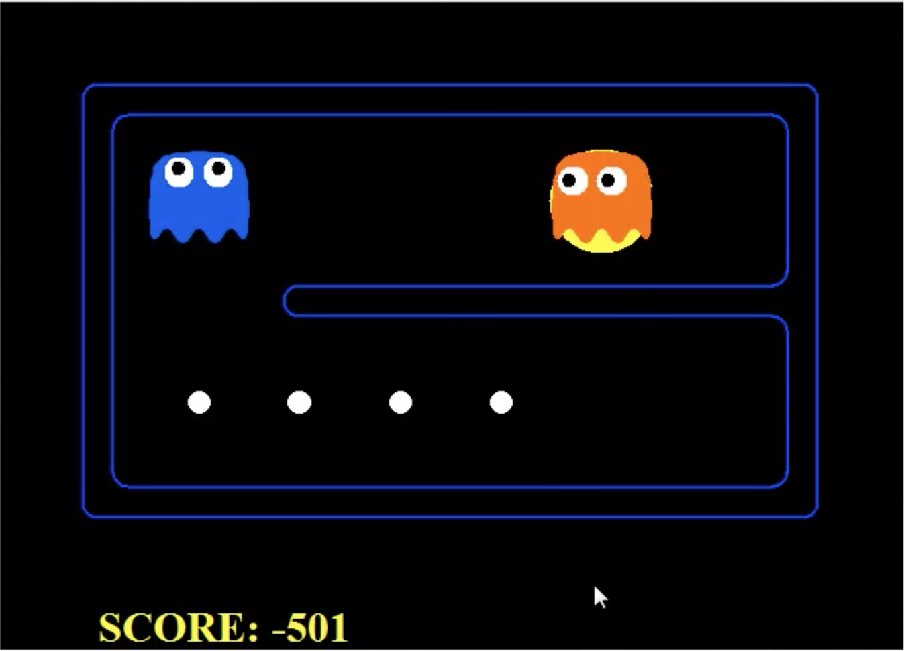
What should PacMan do?
Notes:
Assume ghosts are perfect adversaries. Lose 1 point for every move
Suicide! If living longer you might as well finish it now (in the context of Pacman only).

Slide 24
What should PacMan do?
Notes:
Assume ghosts are perfect adversaries. Lose 1 point for every move
Suicide! If living longer you might as well finish it now (in the context of Pacman only).

Slide 25
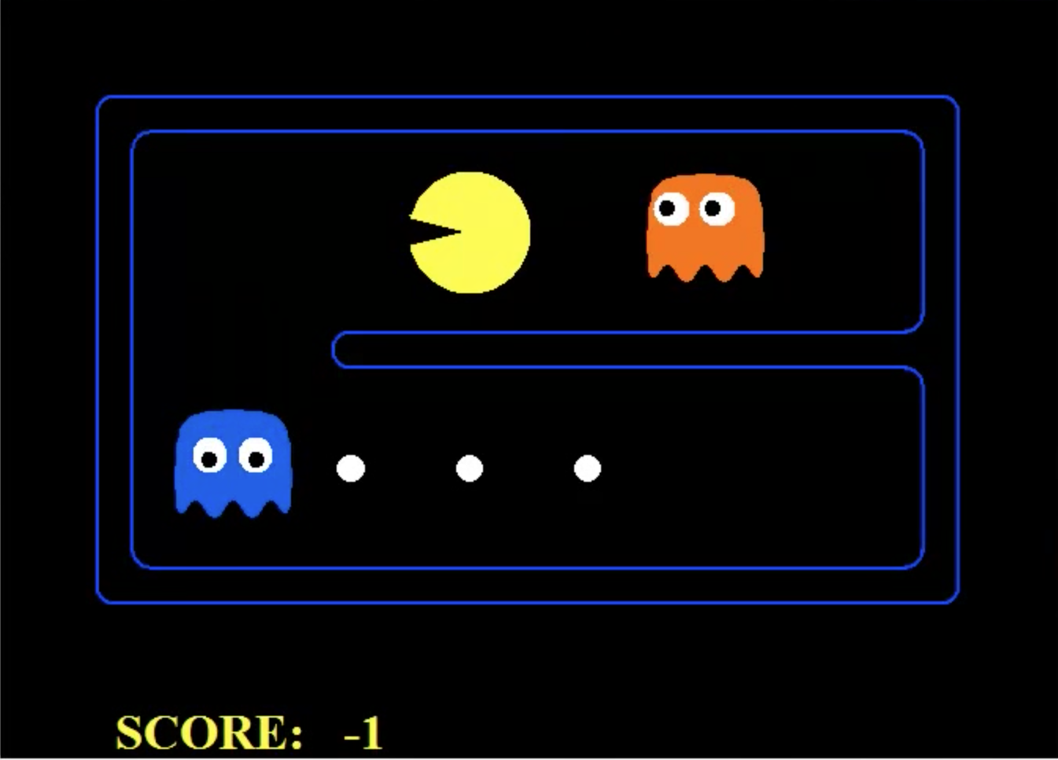
What should PacMan do?
Notes:
Imperfect adverseries

Slide 26
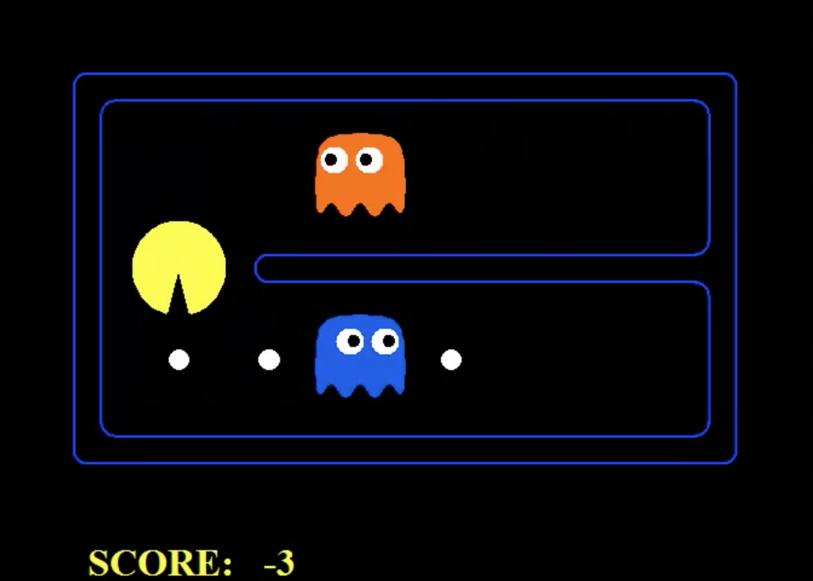
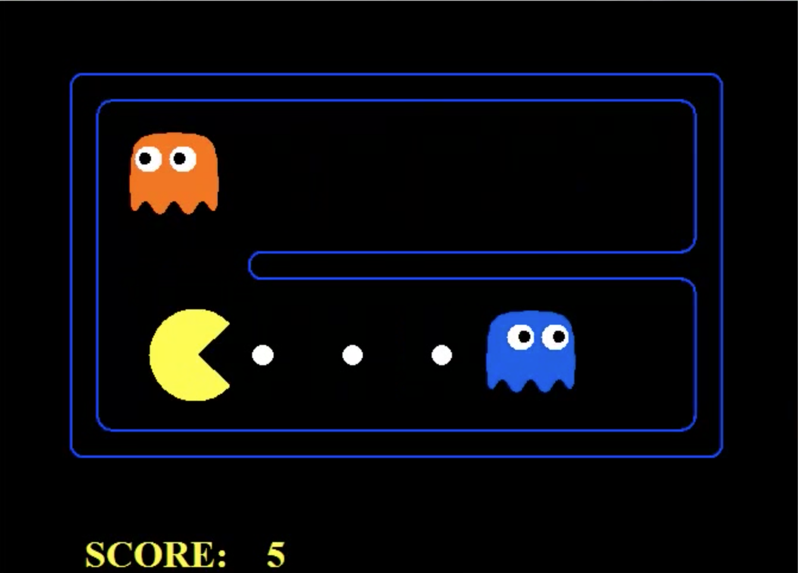
What should PacMan do?
Notes:
Imperfect adverseries

Slide 27
What should PacMan do?
Notes:
Imperfect adverseries

Slide 28
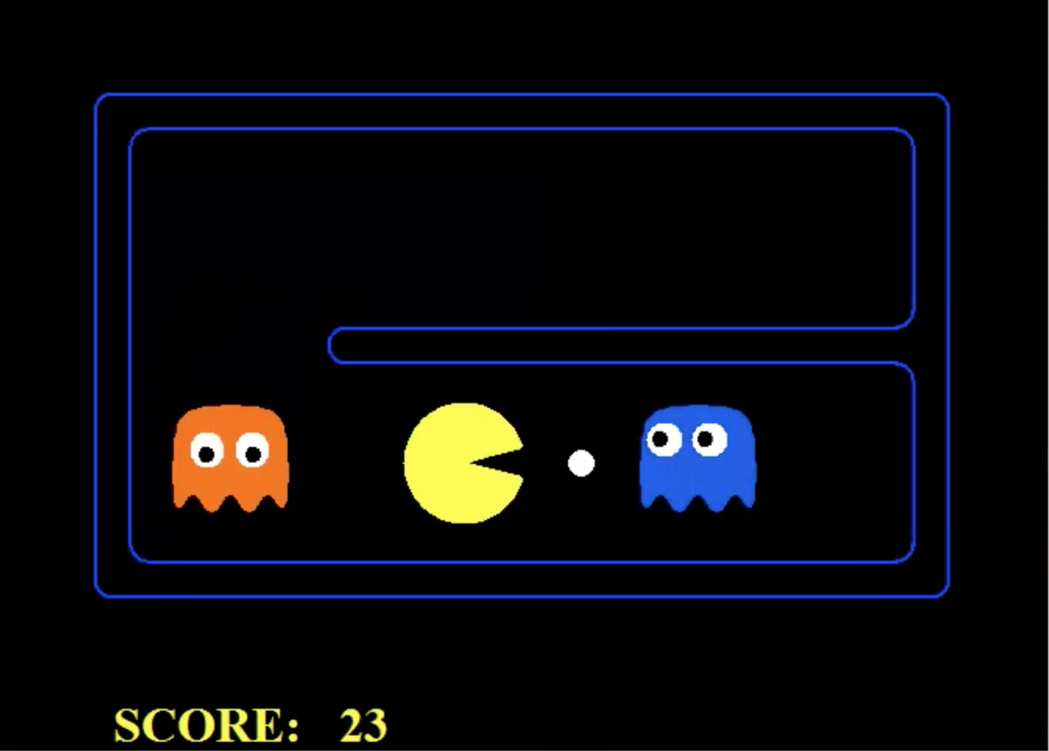
What should PacMan do?
Notes:
Imperfect adverseries

Slide 29
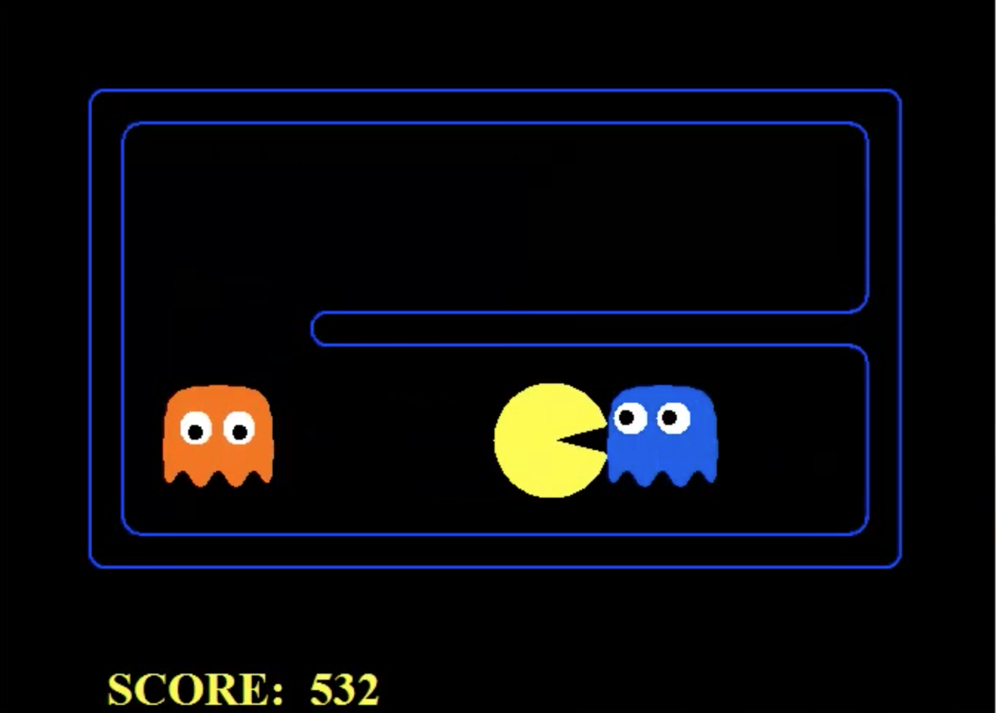
What should PacMan do?
Notes:
Imperfect adverseries

Slide 30

Video of Demo Min vs. Exp (Min)

Slide 31
Video of Demo Min vs. Exp (Exp)

Slide 32

Resource Limits

Slide 33
Resource Limits
Problem: In realistic games, cannot search to leaves!
Solution: Depth-limited search
Instead, search only to a limited depth in the tree
Replace terminal utilities with an evaluation function for non-terminal positions
Example:
Suppose we have 100 seconds, can explore 10K nodes / sec
So can check 1M nodes per move
α-β reaches about depth 8 – decent chess program
Guarantee of optimal play is gone
More plies makes a BIG difference
Use iterative deepening for an anytime algorithm
max
4
-2
4
min
-1
-2
4
9
?
?
?
?

Slide 34
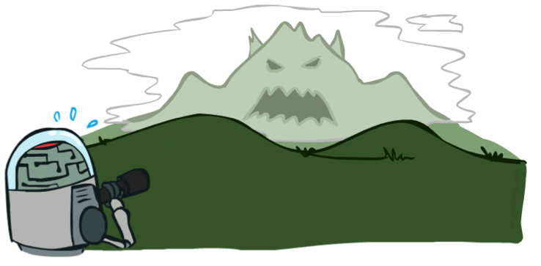

Depth Matters
Evaluation functions are always imperfect
The deeper in the tree the evaluation function is buried, the less the quality of the evaluation function matters
An important example of the tradeoff between complexity of features and complexity of computation
[Demo: depth limited (L6D4, L6D5)]

Slide 35
Video of Demo Limited Depth (2)

Slide 36
Video of Demo Limited Depth (10)

Slide 37
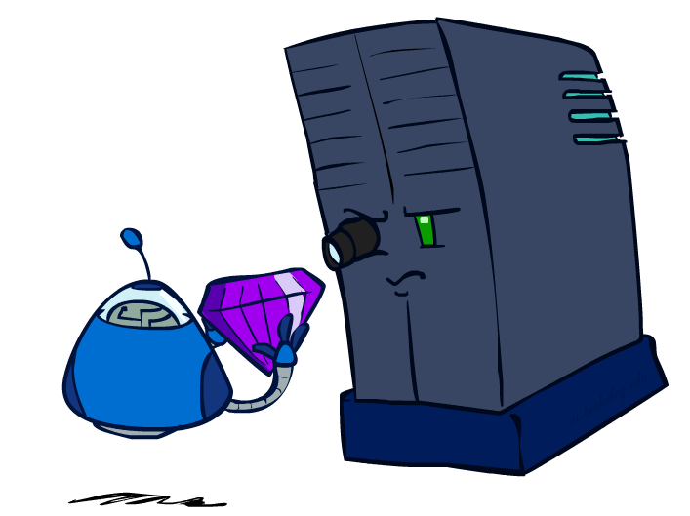
Evaluation Functions

Slide 38
Evaluation Functions
Evaluation functions score non-terminals in depth-limited search
Ideal function: returns the actual minimax value of the position
In practice: typically weighted linear sum of features:
e.g. f₁(s) = (num white queens – num black queens), etc.

Slide 39




Evaluation for Pacman

Slide 40
Video of Demo Thrashing (d=2)

Slide 41
Why Pacman Starves
A danger of replanning agents!
He knows his score will go up by eating the dot now (west, east)
He knows his score will go up just as much by eating the dot later (east, west)
There are no point-scoring opportunities after eating the dot (within the horizon, two here)
Therefore, waiting seems just as good as eating: he may go east, then back west in the next round of replanning!

Slide 42
Video of Demo Thrashing -- Fixed (d=2)

Slide 43
Video of Demo Smart Ghosts (Coordination)

Slide 44
Video of Demo Smart Ghosts (Coordination) – Zoomed In

Slide 45
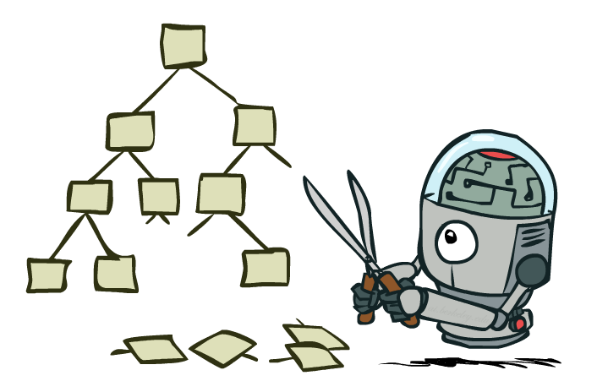
Game Tree Pruning

Slide 46
Minimax Example
3
12
8
2
4
6
14
5
2

Slide 47
Minimax Pruning
3
12
8
2
14
5
2
Notes:
If rightmost subtree had more children we could stop exploring after 2

Slide 48
Alpha-Beta Pruning
General configuration (MIN version)
We’re computing the MIN-VALUE at some node n
We’re looping over n’s children
n’s estimate of the childrens’ min is dropping
Who cares about n’s value? MAX
Let a be the best value that MAX can get at any choice point along the current path from the root
If n becomes worse than a, MAX will avoid it, so we can stop considering n’s other children (it’s already bad enough that it won’t be played)
MAX version is symmetric
MAX
MIN
a
MAX
MIN
n

Slide 49
Alpha-Beta Implementation
α: MAX’s best option on path to root
β: MIN’s best option on path to root
def max-value(state, α, β):
initialize v = -∞
for each successor of state:
v = max(v, value(successor, α, β))
if v ≥ β return v
α = max(α, v)
return v
def min-value(state , α, β):
initialize v = +∞
for each successor of state:
v = min(v, value(successor, α, β))
if v ≤ α return v
β = min(β, v)
return v
Notes:
Pick an order for two reasons: sequential processor and pruning

Slide 50
Alpha-Beta Pruning Properties
This pruning has no effect on minimax value computed for the root!
Values of intermediate nodes might be wrong
Important: children of the root may have the wrong value
So the most naïve version won’t let you do action selection
Good child ordering improves effectiveness of pruning
With “perfect ordering”:
Time complexity drops to O(b^{m/2})
Doubles solvable depth!
Full search of, e.g. chess, is still hopeless…
This is a simple example of metareasoning (computing about what to compute)
max
min
10
10
0

Slide 51
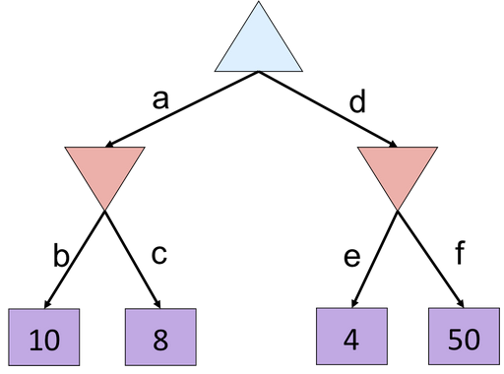
Alpha-Beta Quiz

Slide 52
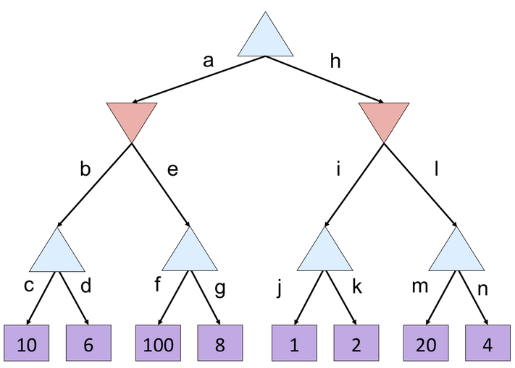
Alpha-Beta Quiz 2

Slide 53
Next Time: Uncertainty!

Slide 54
Iterative Deepening
Iterative deepening uses DFS as a subroutine:
Do a DFS which only searches for paths of length 1 or less. (DFS gives up on any path of length 2)
If “1” failed, do a DFS which only searches paths of length 2 or less.
If “2” failed, do a DFS which only searches paths of length 3 or less.
….and so on.
Why do we want to do this for multiplayer games?
Note: wrongness of eval functions matters less and less the deeper the search goes!
b
…

